Slide 1
MA English Language Teaching: Online
Modern Languages – Faculty of Humanities

Slide 2
Overview
Course design and
development
Demonstration
Student evaluation
Future directions

Slide 3
MA English Language
Teaching: Online
Professional teachers from countries all over the world can take this five-semester (two and
a half years) part-time Master’s programme which is studied entirely online.

Slide 4
MA English Language Teaching: Online
Developed by the University of Southampton in collaboration
with the British Council, it offers postgraduate-level study in important areas of current theory and practice in applied linguistics
and language teaching.

Slide 5
MA English Language Teaching: Online
The course allows practising English language teachers to reflect on their professional experience and update their theoretical and pedagogical knowledge to an advanced level in a flexible
and well-supported learning environment.

Slide 6
Programme structure
Year 1 (two semesters): four modules
Principles of Communicative Language Teaching
Language Analysis for Teaching
Critical Appraisal of Language Teaching Methodologies
E-Learning for English Language Teaching
Year 2 (two semesters): four modules
English as a World Language
Discourse Analysis
Second Language Learning
Research Skills for Dissertation Study
Year 3 (one semester): dissertation

Slide 7
Programme structure
Students should expect a weekly commitment of 10 to 12 hours of online study, including chat room seminars, topic tasks and discussion forums, supported by eight to ten hours of private study.

Slide 8
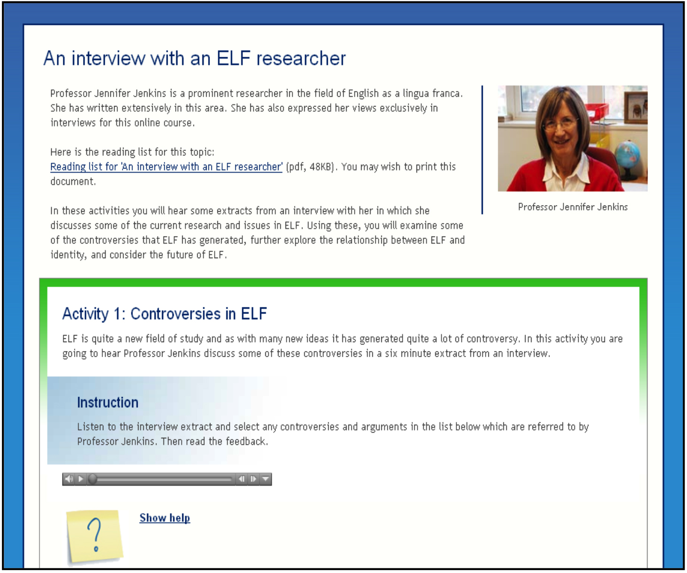
Programme design
We use an innovative approach
to online course design which includes specially designed interactive ‘learning objects’, podcasts and video clips from lectures and seminars given by leading teaching and research
staff at the university.
Studying and reading is supported by extensive electronic resources from the university library.

Slide 9
Content
Each module: 12 topics; podcast introduction/overview from module leader; 36 learning objectives, additional podcasts and videos.
Study guide per topic.
Topic reading list.
Discussion task per topic (tutor-moderated
‘Topic talk’ forum).
Tutored chat sessions.
Module assignment.

Slide 10
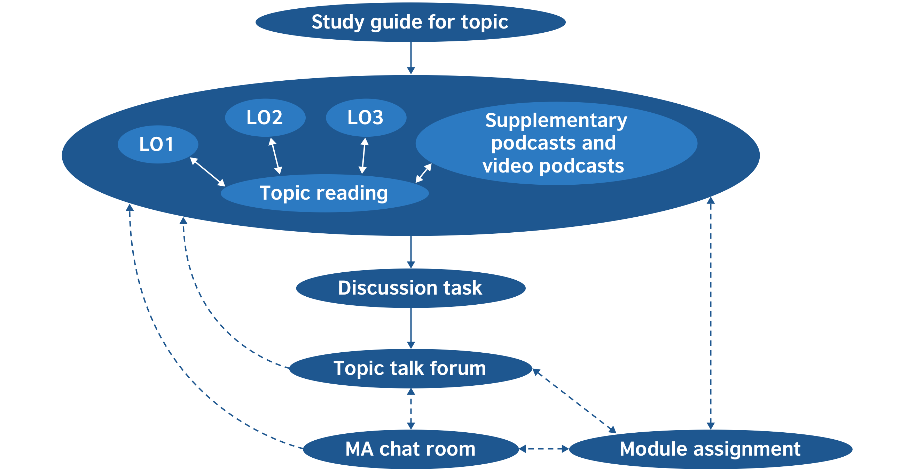
Learning design

Slide 11
Programme and participant structure
Participants
Programme
Students
Tutors
Year
co-ordinator
Module
leader
Programme convenor
Semester 1 | Semester 2
Principles of Communicative Language Teaching | Critical Appraisal of Language Teaching Methodologies
Language Analysis for Teaching | E-Learning for English Language Teaching
Semester 3 | Semester 4
Discourse Analysis | Second Language Learning
World Englishes | Research Skills for the Dissertation
Semester 5
Dissertation

Slide 12
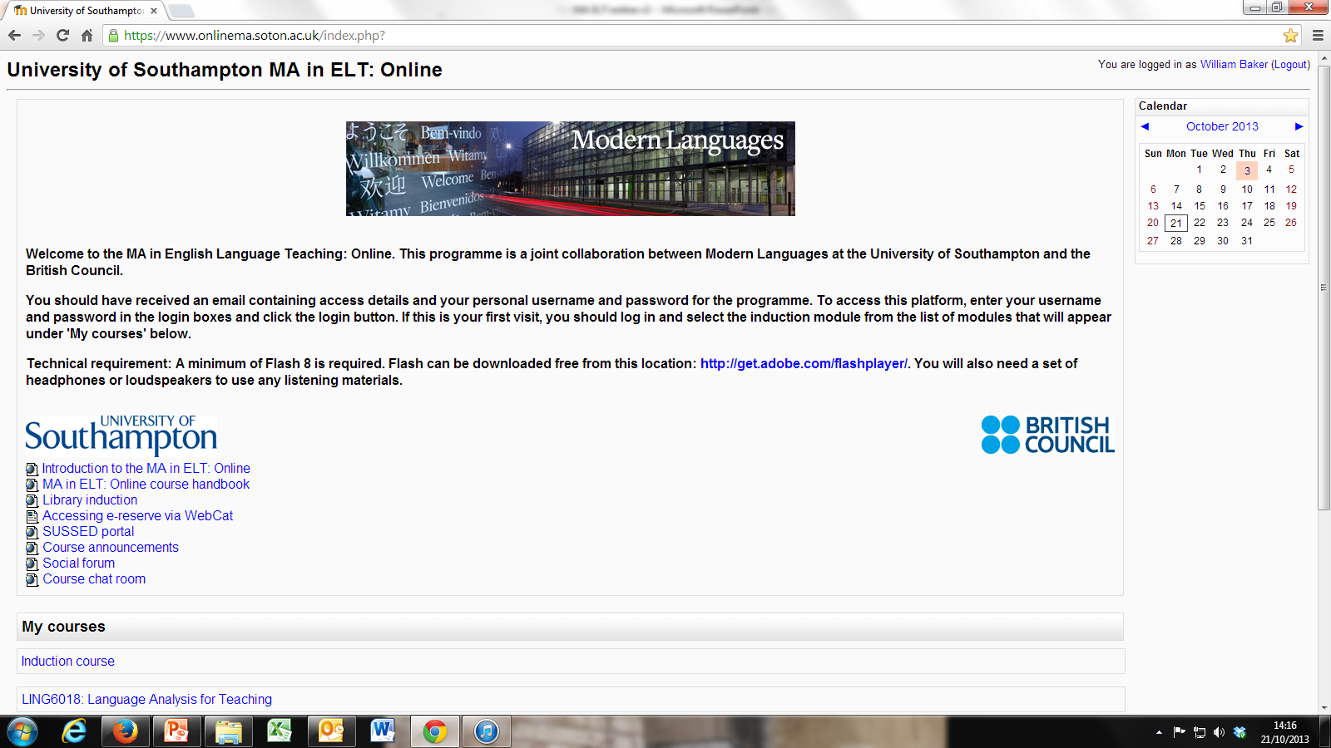
The learning environment

Slide 13
The learning environment
Virtual learning environment (VLE) – University of Southampton
MA in English Language Teaching: Online (customised Moodle)
Module documents and links – all key documents and links are in this area.
Course, Module and Group Forums – where tutors post announcements, news
and information: mostly administrative messages about important dates and events. Students can also post questions here.
Chat room – where students have weekly live text chat sessions with tutors
and fellow students.
Assignments and e-Assignments – instructions for each module assignment and
links to assignment submission.
Topics – specially designed interactive tasks which form the weekly course content
as well as other reading lists or extracts we provide.
Topic Talk Forums – where weekly discussion forum tasks take place.
Email – for communication with tutors and fellow participants.

Slide 14
Example learning objects
A sample from the World Englishes module –
Interview with an ‘English as a Lingua Franca’ researcher
A sample from the Discourse Analysis module –
Social interaction and face

Slide 15
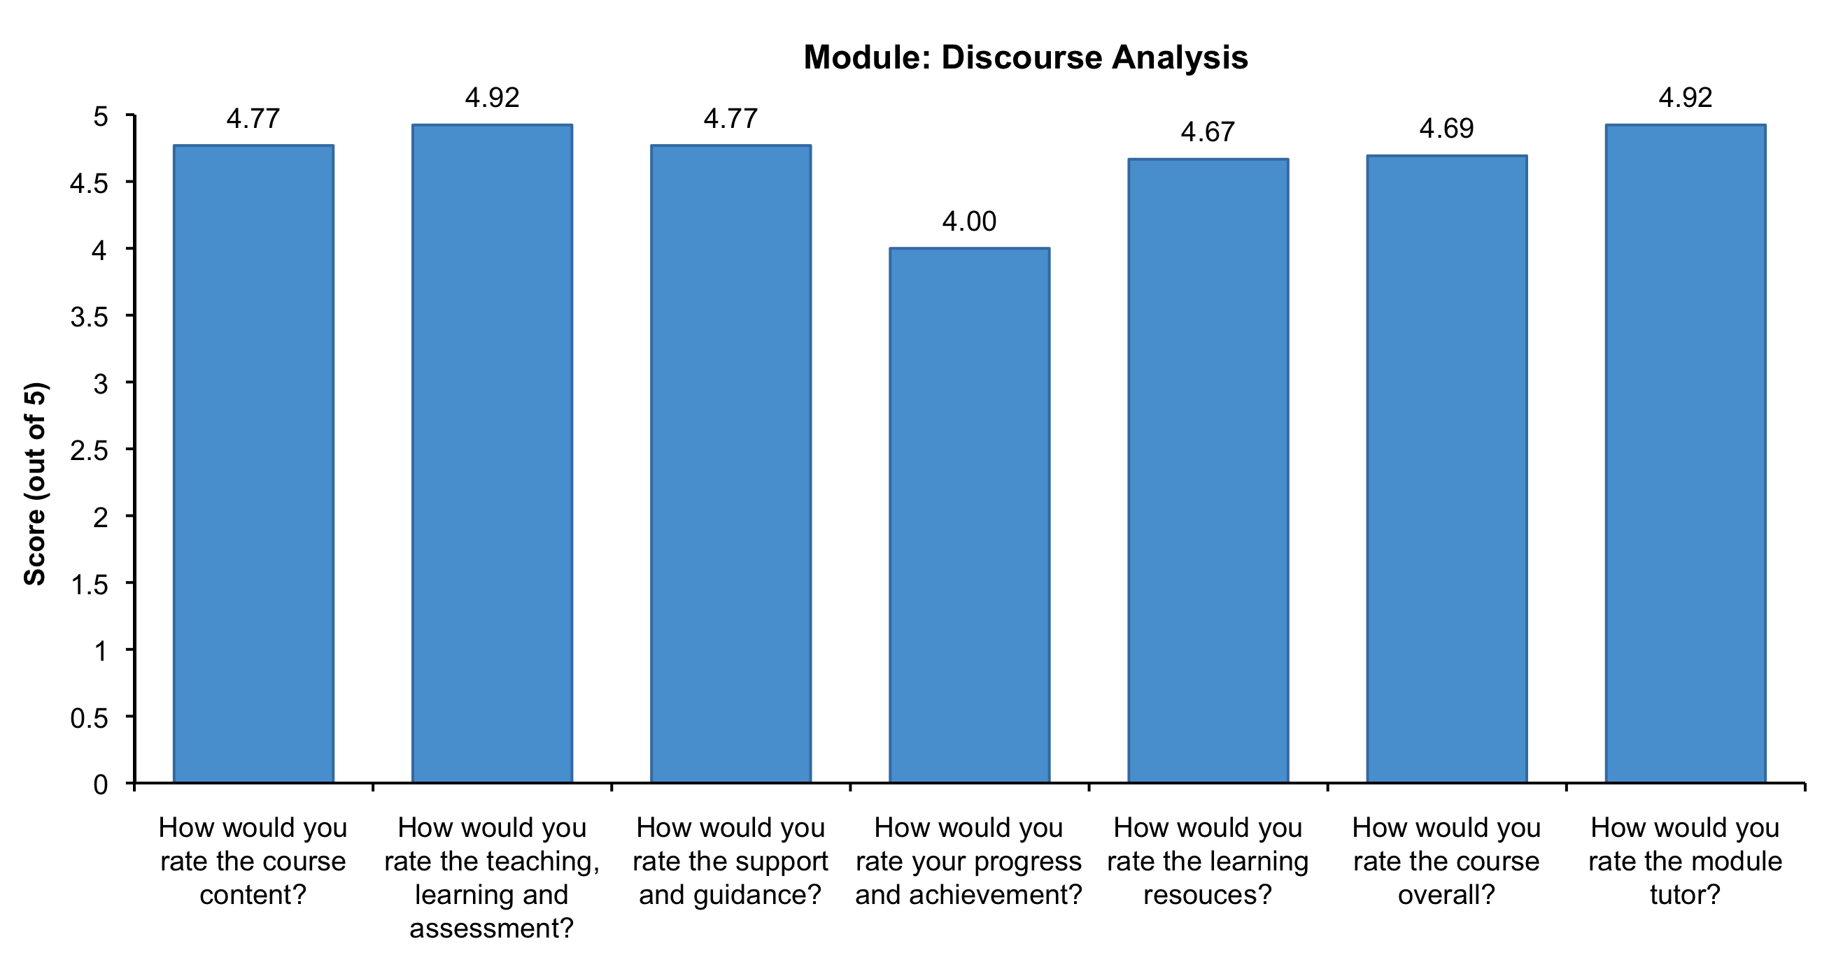
Student evaluation (academic) – 2010

Slide 16
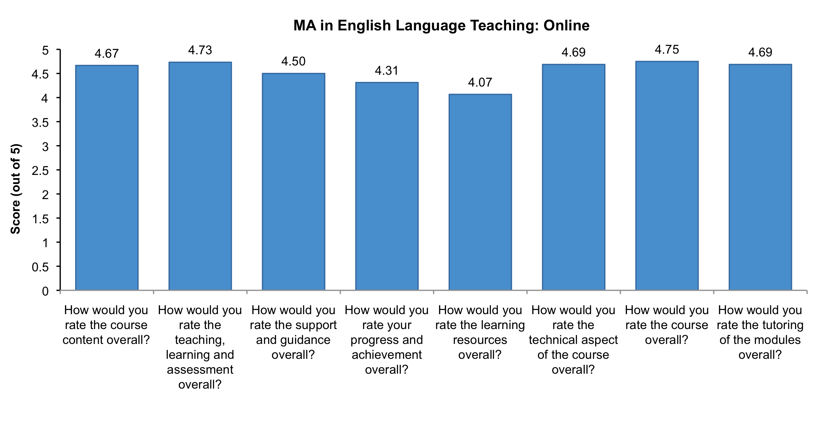
Student evaluation (academic) – 2010

Slide 17
Student evaluation (technical aspects)
Navigation
‘It was very easy to navigate around the course, everything is clearly marked.’
Attractiveness and clarity of presentation
‘The format was clear. What made it attractive was that it was also consistent.’
Platform
‘Access to the platform is fast and easy. The course videos and audios were a nice touch. It gave it more of a human-side to feel connected to a classroom, by being able to see and hear some of the teachers.’
Access to library e-resources
‘I really made use of the library and I also took advantage of the TDNet to look for articles related to my dissertation topic. All the resources were truly useful and I felt I had many options to choose from.’
Learning Objects (module materials)
‘I was very satisfied as the tasks (LOs) focused on key learning points and discussion tasks so that they were useful in preparing the assignments.’

Slide 18




University of Southampton
The University of Southampton is a member
of the prestigious Russell Group and is among
the top 20 research universities in the UK, with
a global reputation for leading-edge research
and teaching.

Slide 19
University of Southampton
MA in English Language Teaching: Online:
www.southampton.ac.uk/humanities/postgraduate/taught_courses/taught_courses/modern_languages_english_language_studies/r900_ma_english_language_teaching_online.page
Applications:
www.southampton.ac.uk/humanities/postgraduate/taught_courses/apply.page
Email:
Programme convenor: w.baker@soton.ac.uk
British Council Project Manager:
MastersELTonline@britishcouncil.org
Images © Mat Wright

